Slide 1
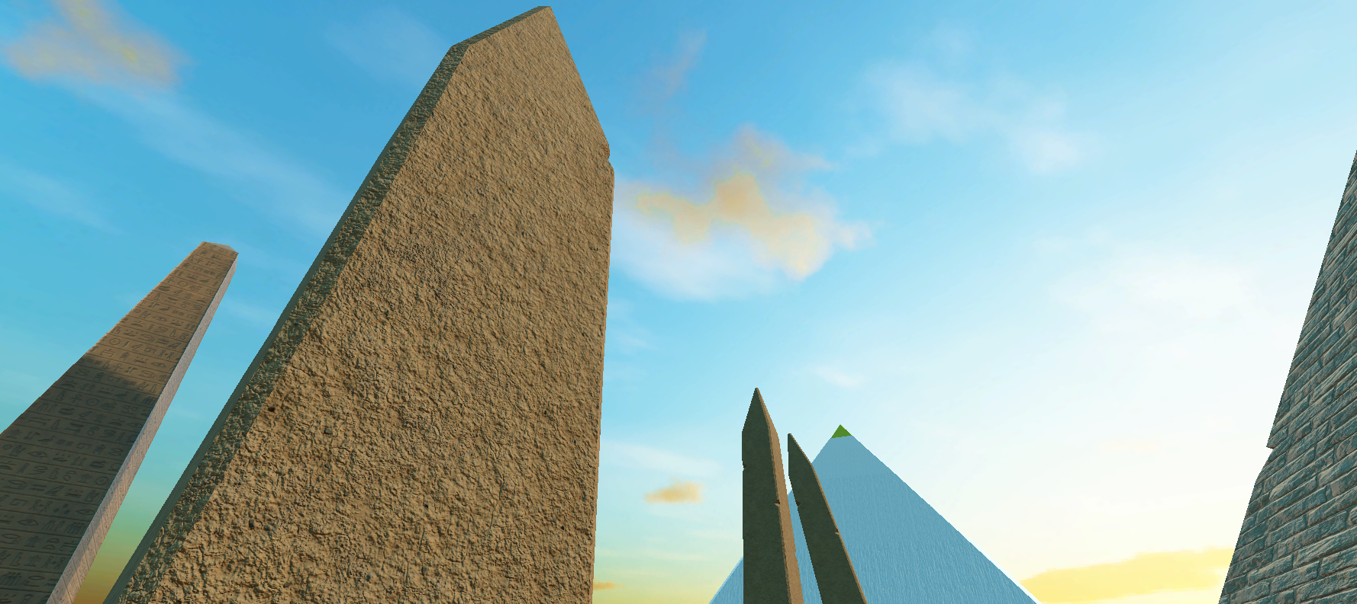
Draw Your Path
מספר הפרויקט - 231408
שם הסדנה – פיתוח משחקים עם Unity
שם המנחה – משה סולאמי
שמות המגישים – יוסף דקה, איסמעיל ג'ובראן ג'בארין

Slide 2
Introduction
An action and adventure VR game developed with Unity which is a powerful tool that simplified our path in making that game
Your main goal is to retrieve an item in the end of the map, but what’s important is the path to retrieving the item

Slide 3
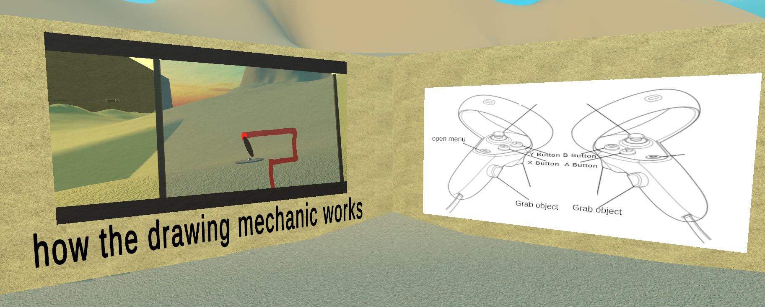
Target audience
This game was made for people who are into the action and adventure genre
No need to have an experience with VR or action/adventure games
An in-game screenshot showing controls at the start of the game

Slide 4
Overview
The game’s main feature is the ability to draw things into existence
The map is constructed from several interconnected areas
In each area the player will encounter enemies
between each area player will have to solve a puzzle in order to move onto the next one
All these obstacles in the player’s playthrough will have to be solved using the drawing feature

Slide 5
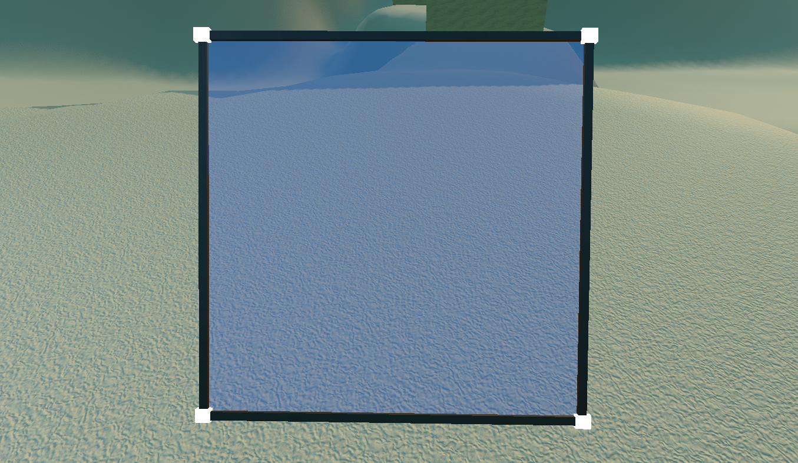
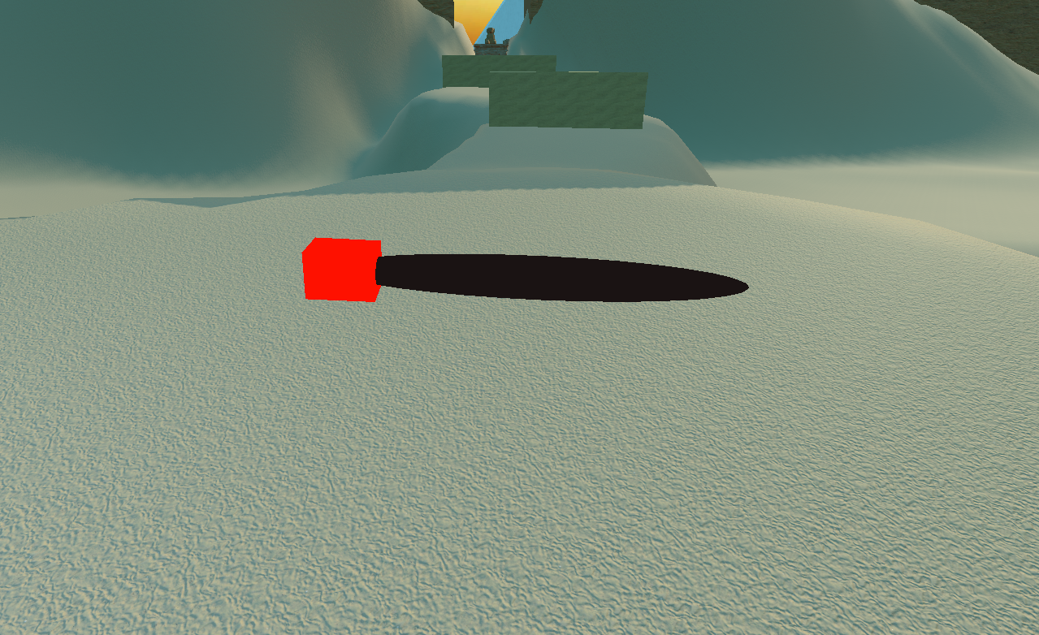
The drawing feature
The tool which enables you to use the drawing feature is a marker and a draw canvas
The draw canvas
The marker

Slide 6
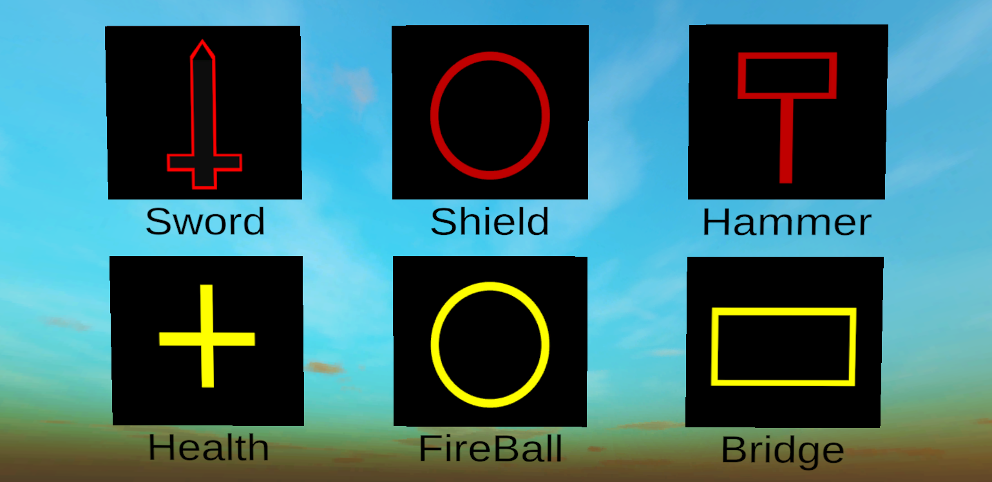
You will be provided with a set of items/spells that you will be able to draw and use
The more accurate your drawing is the more effective the item/spell will be
In-game screenshot, you can look at the set anytime you want during the game

Slide 7
Snippet from game
https://youtu.be/rs2VX241ERs

Slide 8
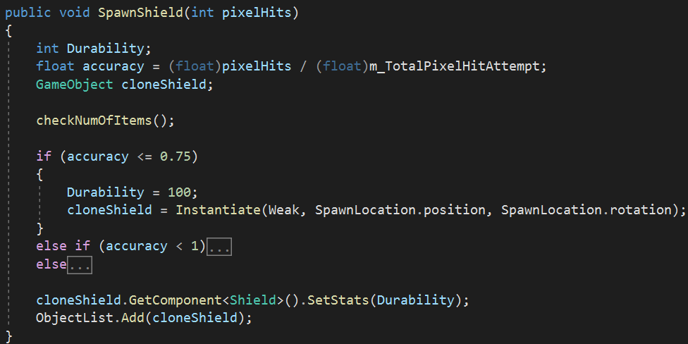
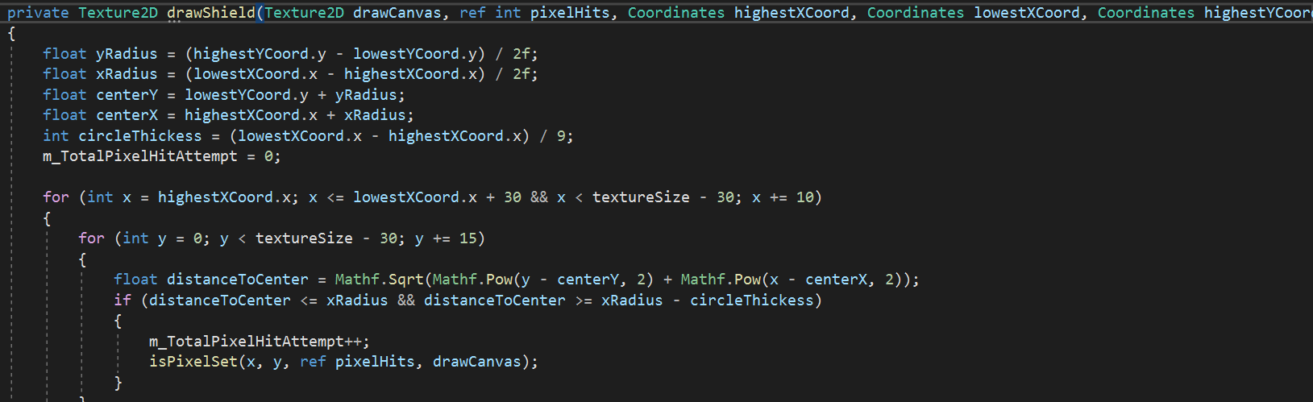
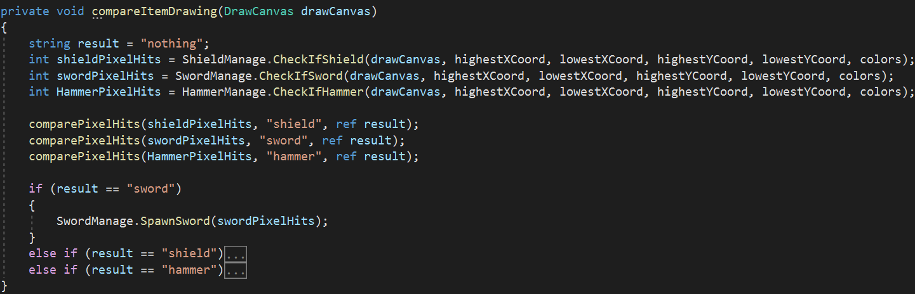
Game Architecture

Slide 9
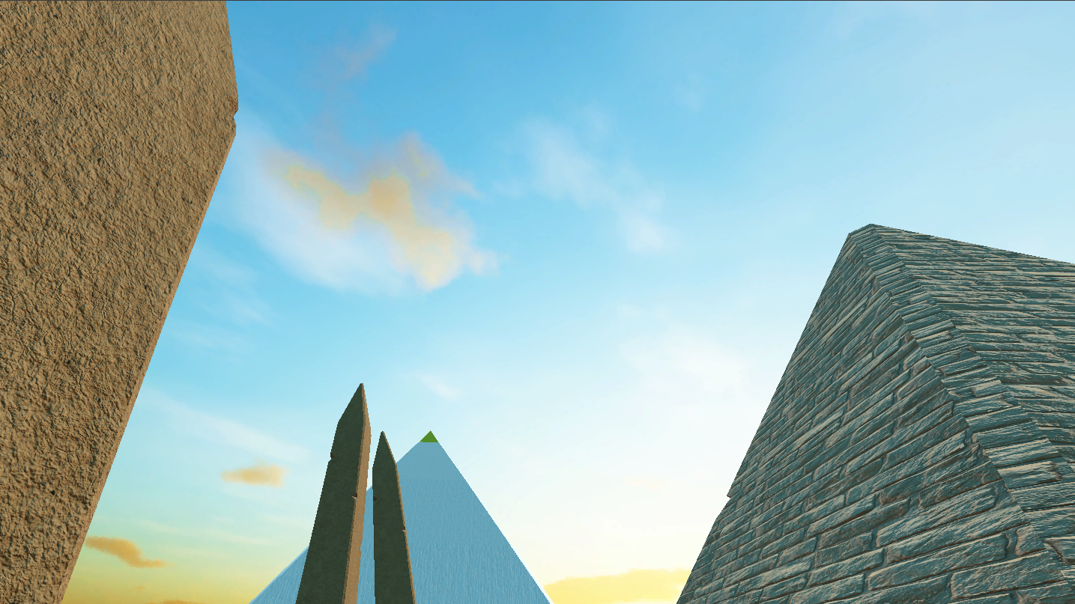
Summary
As developers who had no experience in creating 3D games moreover a VR game as the games we developed before the project were played on the console screen, it was nice to have a framework like Unity which offers a wide variety of tools that helped us to create the game we had in mind
Overall, the game’s drawing feature allows the player to interact with the world we built in many ways which will give every player a unique experience

